Slide 1

Impact of Car Features trainity Project#7
By:
ANURAG CHANGMAI
Data Analytics Trainee

Slide 2
Project Description
Cars, and vehicles as a whole, form an indispensable part of our daily lives. They have become essential as modes of transport, and have seen immense growth over the years. With growth, however, comes great competition and a quickly changing consumer landscape. Environmental concerns too have played their part in affecting consumer mindset, and as a result, it becomes crucial for automotive manufacturers to gauge this trend and be prepared for any upsets.
In this project, I take the role of a Data Analyst in a car manufacturer that wants to optimize pricing and product development decisions to maximize profitability while meeting consumer demand. As such, I analyze the relationships between various car features and identify those that are most beneficial for the manufacturer. My intention is to improve the manufacturer’s competitiveness in the cutthroat market and increase profitability over time.

Slide 3
Approach
This project begins by first obtaining a sample dataset of various car models and their relevant parameters. This dataset carries information on 11915 car models, with parameters such as fuel type, engine power, transmission type, market category, etc.
This data is then cleaned before being used, and outliers are noted to ensure all data points are taken into consideration. For better clarity, data is represented in a tabular form and a chart form wherever possible.

Slide 4
Tech-stack used
In the execution of this project, the following software was used:
1. Microsoft Excel 2019 v2307
→ It was used to understand the data, which was in XLSX format, clean it, filter it, obtain results from it, and display the same in tabular and chart forms.

Slide 5
Insights
Over the following slides, I will try to obtain insights on:
How popularity of a car model varies across different market categories
The relationship between a car’s engine power and its price
Which car features are most important in determining a car's price
How the average price of a car vary across different manufacturers
The relationship between fuel efficiency and the number of cylinders in a car's engine

Slide 6
Cleaning the data
Before diving into the data to obtain insights, I had to clean the data and make it ready for analysis. The following steps were performed during the data-cleaning process:
Saab had models as 09-Mar and 09-May. These were actually 9-3 and 9-5 models and were replaced accordingly.
Following categories had as many blanks:
Engine Fuel Type 3
Engine HP 69
Engine Cylinders 30
Number of Doors 6

Slide 7
Cleaning the data (Cont.)
These blanks were replaced with accurate figures obtained from the internet as follows:
3 blanks in Engine Fuel Type were for the Suzuki Verona → replaced by 'regular unleaded’
69 blanks in Engine HP were filled with data from official sources. For multiple engine options, the HP value was kept at entry-level model/base model HP values.
30 blanks in Engine Cylinders were filled as follows:
For electric vehicles Chevrolet Bolt EV, Volkswagen e-Gold, Mitsubishi i-MiEV, and Toyota RAV4 EV, no. of cylinders is 0.
For Mazda RX-7 and RX-8, which use Wankel engines, no. of cylinders is 1.
6 blanks in Number of Doors were filled as follows:
Ferrari FF → 2 doors
Tesla Model S → 4 doors

Slide 8
1. How popularity of a car model varies across different market categories
Row Labels | Count of Make | Average of Popularity
Crossover | 1110 | 1545.26
Crossover,Diesel | 7 | 873.00
Crossover,Exotic,Luxury,High-Performance | 1 | 238.00
Crossover,Exotic,Luxury,Performance | 1 | 238.00
Crossover,Factory Tuner,Luxury,High-Performance | 26 | 1823.46
Crossover,Factory Tuner,Luxury,Performance | 5 | 2607.40
Crossover,Factory Tuner,Performance | 4 | 210.00
Crossover,Flex Fuel | 64 | 2073.75
Crossover,Flex Fuel,Luxury | 10 | 1173.20
Crossover,Flex Fuel,Luxury,Performance | 6 | 1624.00
Crossover,Flex Fuel,Performance | 6 | 5657.00
Crossover,Hatchback | 72 | 1675.69
Crossover,Hatchback,Factory Tuner,Performance | 6 | 2009.00
Crossover,Hatchback,Luxury | 7 | 204.00
Crossover,Hatchback,Performance | 6 | 2009.00
Crossover,Hybrid | 42 | 2563.38
Crossover,Luxury | 410 | 884.55
Crossover,Luxury,Diesel | 34 | 2149.41
Crossover,Luxury,High-Performance | 9 | 1037.22
Crossover,Luxury,Hybrid | 24 | 630.92
Crossover,Luxury,Performance | 113 | 1344.85
Crossover,Luxury,Performance,Hybrid | 2 | 3916.00
Crossover,Performance | 69 | 2585.96
Diesel | 84 | 1730.90
Diesel,Luxury | 51 | 2275.00
Exotic,Factory Tuner,High-Performance | 21 | 1046.38
Exotic,Factory Tuner,Luxury,High-Performance | 52 | 517.54
Exotic,Factory Tuner,Luxury,Performance | 3 | 520.00
Exotic,Flex Fuel,Factory Tuner,Luxury,High-Performance | 13 | 520.00
Exotic,Flex Fuel,Luxury,High-Performance | 11 | 520.00
Exotic,High-Performance | 261 | 1271.33
Exotic,Luxury | 12 | 112.67
Exotic,Luxury,High-Performance | 79 | 467.08
Exotic,Luxury,High-Performance,Hybrid | 1 | 204.00
Exotic,Luxury,Performance | 36 | 217.03
Exotic,Performance | 10 | 1391.00
Factory Tuner,High-Performance | 106 | 1941.42
Factory Tuner,Luxury | 2 | 617.00
Factory Tuner,Luxury,High-Performance | 215 | 2133.37
Factory Tuner,Luxury,Performance | 31 | 1413.42
Factory Tuner,Performance | 92 | 1695.70
Flex Fuel | 872 | 2217.30
Flex Fuel,Diesel | 16 | 5657.00
Flex Fuel,Factory Tuner,Luxury,High-Performance | 1 | 258.00
Flex Fuel,Hybrid | 2 | 155.00
Flex Fuel,Luxury | 39 | 746.54
Flex Fuel,Luxury,High-Performance | 33 | 878.91
Flex Fuel,Luxury,Performance | 28 | 1380.07
Flex Fuel,Performance | 87 | 1680.47
Flex Fuel,Performance,Hybrid | 2 | 155.00
Hatchback | 641 | 1318.87
Hatchback,Diesel | 14 | 873.00
Hatchback,Factory Tuner,High-Performance | 13 | 1205.15
Hatchback,Factory Tuner,Luxury,Performance | 9 | 886.89
Hatchback,Factory Tuner,Performance | 22 | 2159.05
Hatchback,Flex Fuel | 7 | 5657.00
Hatchback,Hybrid | 72 | 2121.25
Hatchback,Luxury | 46 | 1379.50
Hatchback,Luxury,Hybrid | 3 | 454.00
Hatchback,Luxury,Performance | 38 | 1566.13
Hatchback,Performance | 252 | 1039.65
High-Performance | 199 | 1821.45
Hybrid | 123 | 2105.57
Luxury | 855 | 1102.66
Luxury,High-Performance | 334 | 1668.02
Luxury,High-Performance,Hybrid | 12 | 568.83
Luxury,Hybrid | 52 | 673.63
Luxury,Performance | 673 | 1292.62
Luxury,Performance,Hybrid | 11 | 2333.18
N/A | 3742 | 1676.89
Performance | 601 | 1348.87
Performance,Hybrid | 1 | 155.00
Grand Total | 11914 | 1554.91
This information was obtained using a Pivot table, where all the unique market categories were tabulated along with the count of vehicles in the respective categories and the average popularity values of the vehicles in these categories.
The table thus obtained is shown on the right, with the Pivot chart plotted on the next slide.
From this, we can see that ‘Crossover, Flex Fuel, Performance’, ‘Flex Fuel, Diesel’, and ‘Hatchback, Flex Fuel’ have the highest popularity.

Slide 9
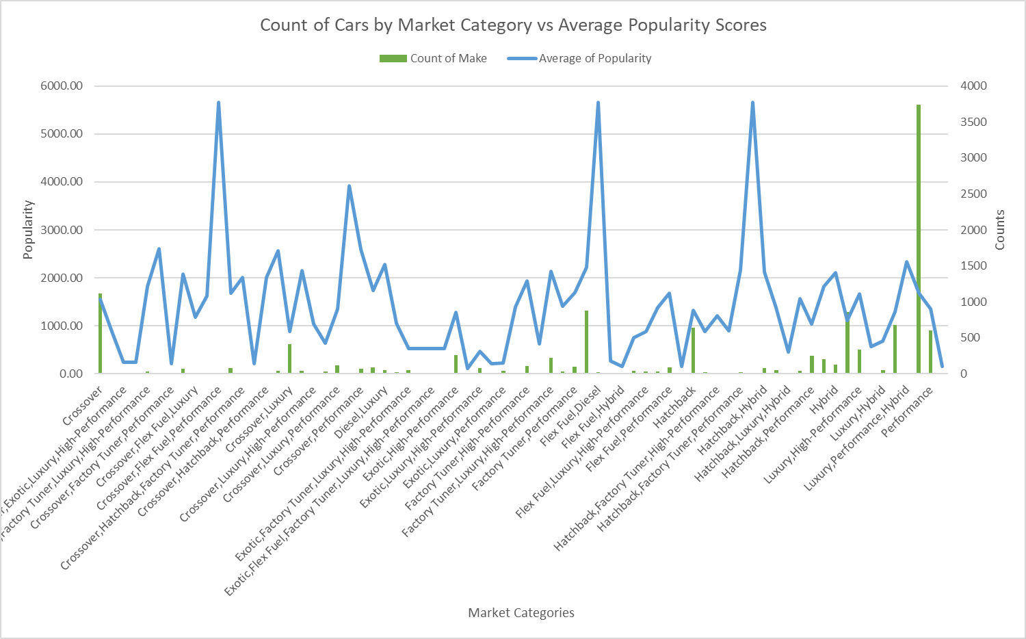
1. How popularity of a car model varies across different market categories (Cont.)

Slide 10
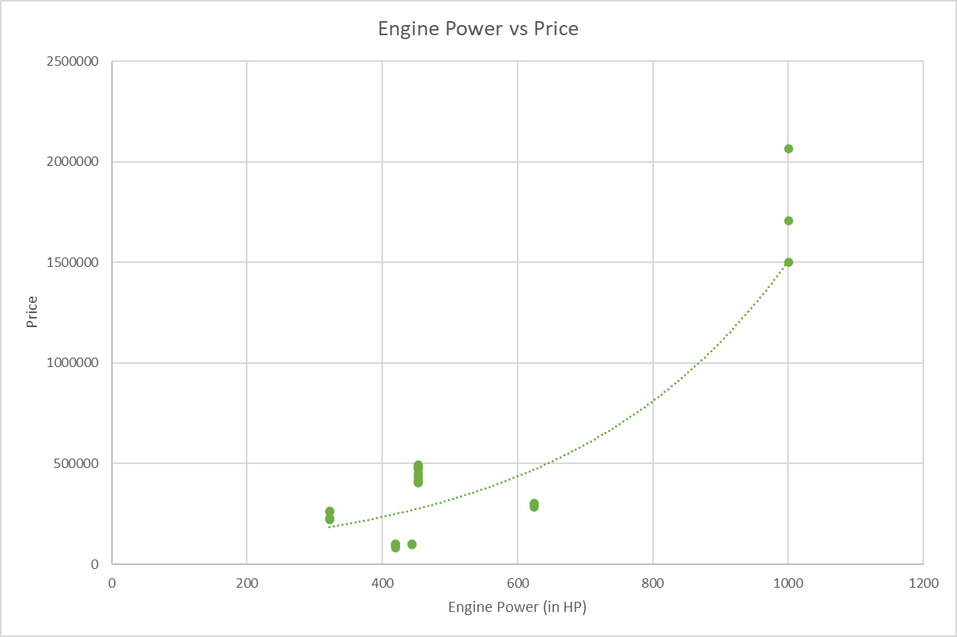
2. The relationship between a car’s engine power and its price
This information was obtained using a scatter chart, that plots engine power on the x-axis and price on the y-axis.
The chart thus obtained is shown on the right.
From this, we can see that as engine power increases, price also increases rapidly.

Slide 11
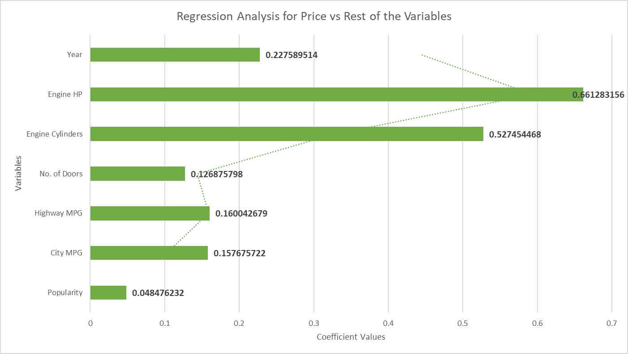
3. Which car features are most important in determining a car's price
This information was obtained by performing regression analysis on price versus all the other variables (year, engine HP, engine cylinders, no. of doors, highway MPG, city MPG, and popularity).
The Multiple R values (present in the datasheet) were used as coefficient values and plotted using a bar graph.
From this, we can see that engine HP has the strongest relationship with a car’s price.

Slide 12
4. How the average price of a car vary across different manufacturers
Manufacturer | Average Price
Acura | 34887.59
Alfa Romeo | 61600.00
Aston Martin | 197910.38
Audi | 53452.11
Bentley | 247169.32
BMW | 61546.76
Bugatti | 1757223.67
Buick | 28206.61
Cadillac | 56231.32
Chevrolet | 28350.39
Chrysler | 26722.96
Dodge | 22390.06
Ferrari | 238218.84
FIAT | 22670.24
Ford | 27399.27
Genesis | 46616.67
GMC | 30493.30
Honda | 26674.34
HUMMER | 36464.41
Hyundai | 24597.04
Infiniti | 42394.21
Kia | 25310.17
Lamborghini | 331567.31
Land Rover | 67823.22
Lexus | 47549.07
Lincoln | 42839.83
Lotus | 69188.28
Maserati | 114207.71
Maybach | 546221.88
Mazda | 20039.38
McLaren | 239805.00
Mercedes-Benz | 71476.23
Mitsubishi | 21240.54
Nissan | 28583.43
Oldsmobile | 11542.54
Plymouth | 3122.90
Pontiac | 19321.55
Porsche | 101622.40
Rolls-Royce | 351130.65
Saab | 27413.50
Scion | 19932.50
Spyker | 213323.33
Subaru | 24827.50
Suzuki | 17907.21
Tesla | 85255.56
Toyota | 29030.02
Volkswagen | 28102.38
Volvo | 28541.16
Grand Total | 40594.74
This information was obtained using a Pivot table, where all the unique manufacturers were tabulated along with the average prices of all their respective models.
The table thus obtained is shown on the right, with the Pivot chart plotted on the next slide.
From this, we can see that Plymouth has the lowest average price at 3122.90 while Bugatti has the highest average price at 1757223.67.

Slide 13
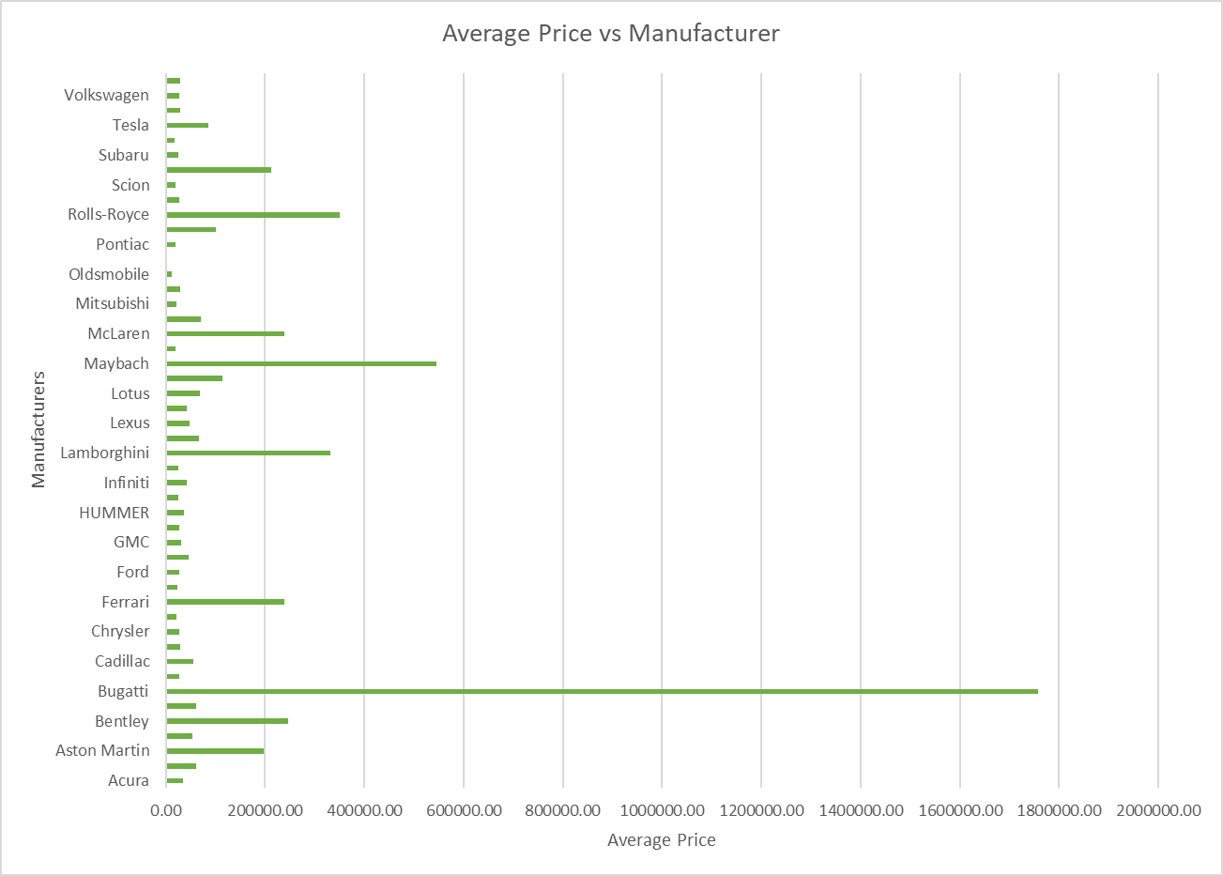
4. How the average price of a car vary across different manufacturers (Cont.)

Slide 14
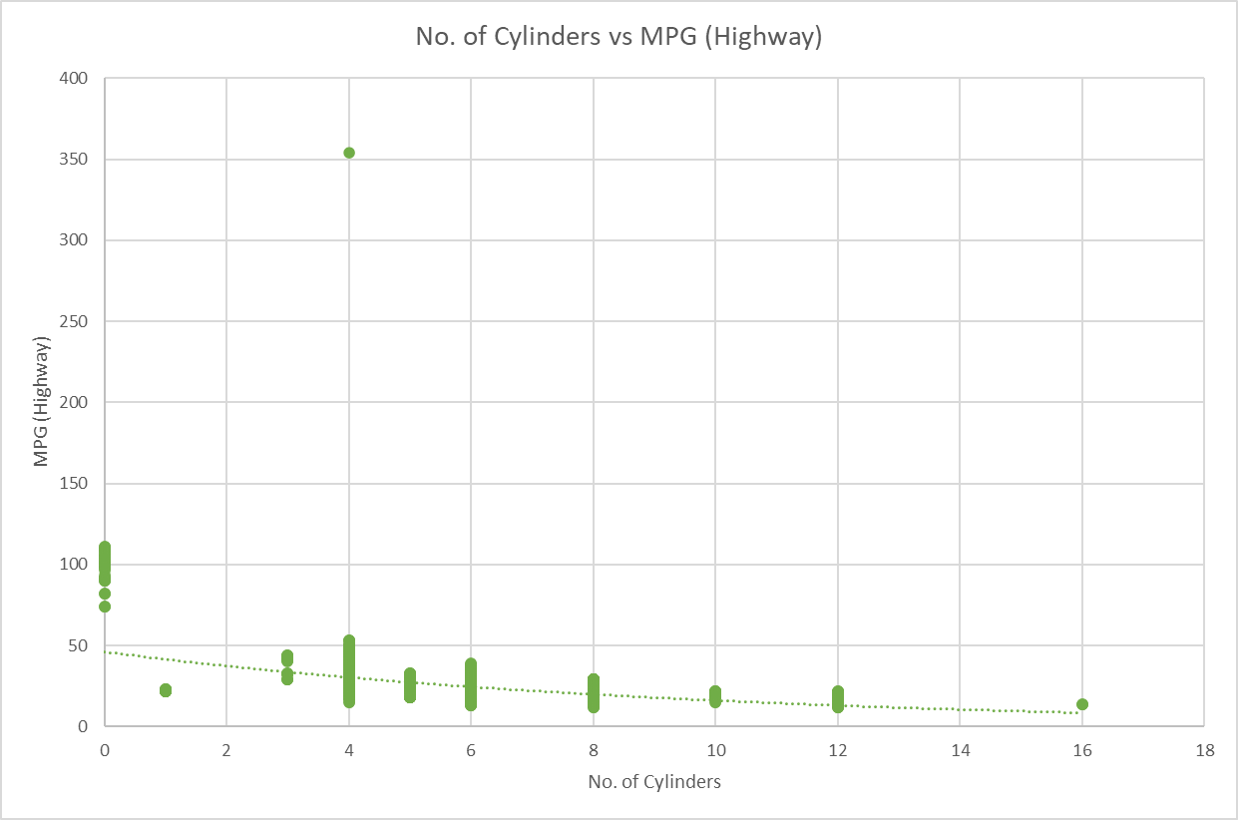
5. The relationship between fuel efficiency and the number of cylinders in a car's engine
This information was obtained using a scatter chart, that plots no. of cylinders on the x-axis and highway MPG on the y-axis.
The chart thus obtained is shown on the right, along with a trendline to indicate the slope of the observations.
From this, we can see that as no. of cylinders increases, highway MPG decreases gradually.

Slide 15
5. The relationship between fuel efficiency and the number of cylinders in a car's engine (Cont.)
No. of cylinders | Avg. highway MPG | Correlation Coefficient
1 | 22.5 | -0.749030238
3 | 38.67
4 | 31.5
5 | 26.66
6 | 23.88
8 | 20.08
10 | 20.01
12 | 17.73
16 | 14
The correlation coefficient between the no. of cylinders and highway MPG is shown on the right.
This was obtained by considering the average highway MPG for each cylinder count and then using the formula:
=CORREL(P3:P11,Q3:Q11)
Consequently, the correlation coefficient was found to be -0.749, which shows a negative correlation, indicating our previous observation that highway MPG decreases as no. of cylinders increases.

Slide 16
Final Dashboard
Having found all the aforementioned insights, I created a dashboard containing charts showing different plots of various parameters. This included:
Car prices by brand and body style
Average MSRPs across brand and body style
Average MSRPs by transmission type and body style
Fuel efficiency over time across body styles
Average HP vs MPG vs MSRP across different car brands
I utilized slicers that were connected to these charts so that they could help filter data as required and show relevant chart plots for better visual representation. The final dashboard is shown in the next slide.

Slide 17
Final Dashboard

Slide 18
Result
Based on the insights obtained here, it can be seen that the ‘Crossover, Flex Fuel, Performance’, ‘Flex Fuel, Diesel’, and ‘Hatchback, Flex Fuel’ market categories are the most preferred by the current group of consumers. Hence, the car manufacturer can be advised to focus on these categories with vehicles of median engine HP and engine cylinder values to improve profitability and cater to the current demand of consumers.
This project has been instrumental in fostering an understanding of how car manufacturers study market trends and ideate, design, and produce vehicles that cater to current and future market trends. It also helped me understand the various types of vehicles available to the consumer and obtain a general idea of what impacts consumer choices when it comes to buying a car.
The full dataset can be found using this link.

